Slide 1
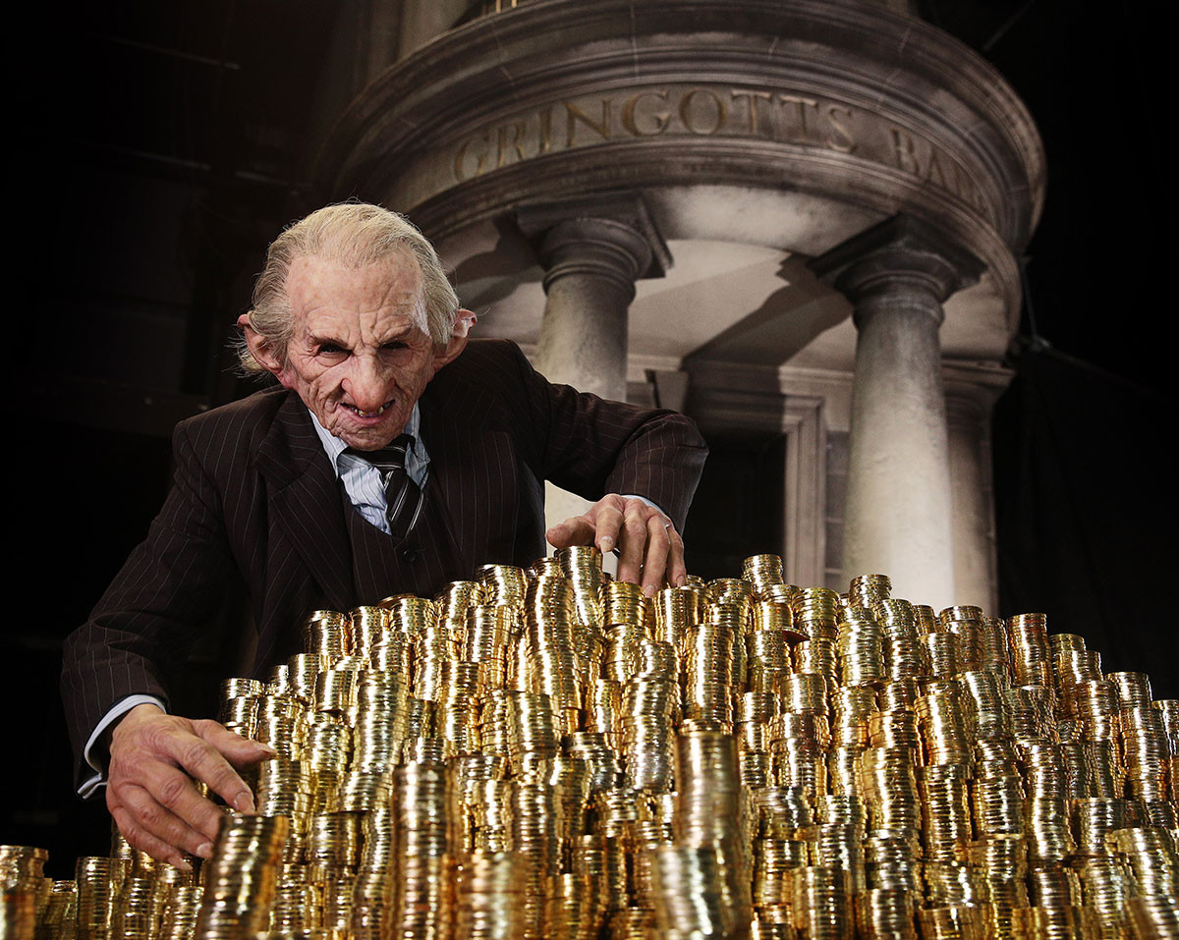
Better Understanding Our Customers
Lily Potter

Slide 2


Business Question: What, Why, How
Who will accept a credit card?
What are variables and characteristics that influence customer decision most?
Targeting marketing efforts on customers that are likely to accept our offers
Making Sales aware of how a solvent lead is characterized
Development of a machine learning model to regular feed customer data into
Heatmapping of characteristics, qualitative analysis

Slide 3



Process
Our Database and Results from Marketing
Cleaning, Wrangling, EDA,
Pre-processing, Predictions
Preparing graphs and results for management
Extract to .csv and import to tableau
Extraction with SQL

Slide 4
Process
5th
hybrid: Smote, Tomek, dropping Q1, Q2, Q3, Q4
73% accuracy score
1st No sampling technique. 94% but no positive
4th Drop columns (no of bank accounts)
71% accuracy score
2nd
SMOTE sampling technique 72% accuracy score
3rd
random oversampling
69 % accuracy

Slide 5
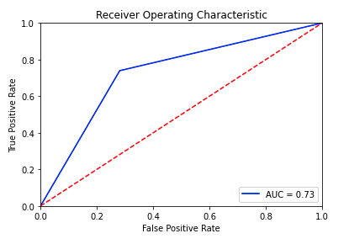
Learning
Characteristics of an “accepter”
Preferred Reward – “Air Miles”
Homeowner
Income Level low– medium, usually no overdraft protection
1-2 accounts
We are able to predict with auc 73%
We can target marketing activities more precisely
Potential savings per customer?

Slide 6
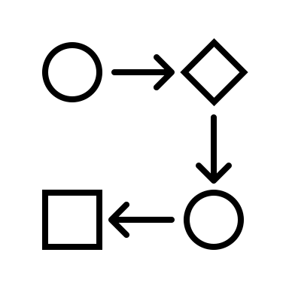

Next Steps
Transfer the developed method into business processes for marketing
Setup data streams from database into CRM system
Programming data processing
Creating dashboards for different marketing user groups
Training staff on how to run reports and amend them if necessary.
Should we sell the targeted person a credit card or not?
Correlation between prediction and credit rating?
Can we predict credit rating with a high accuracy?

Slide 7
Thank You!

